Slide 1
Welcome to 4th Grade Parent Night! August 14, 2018

Slide 2
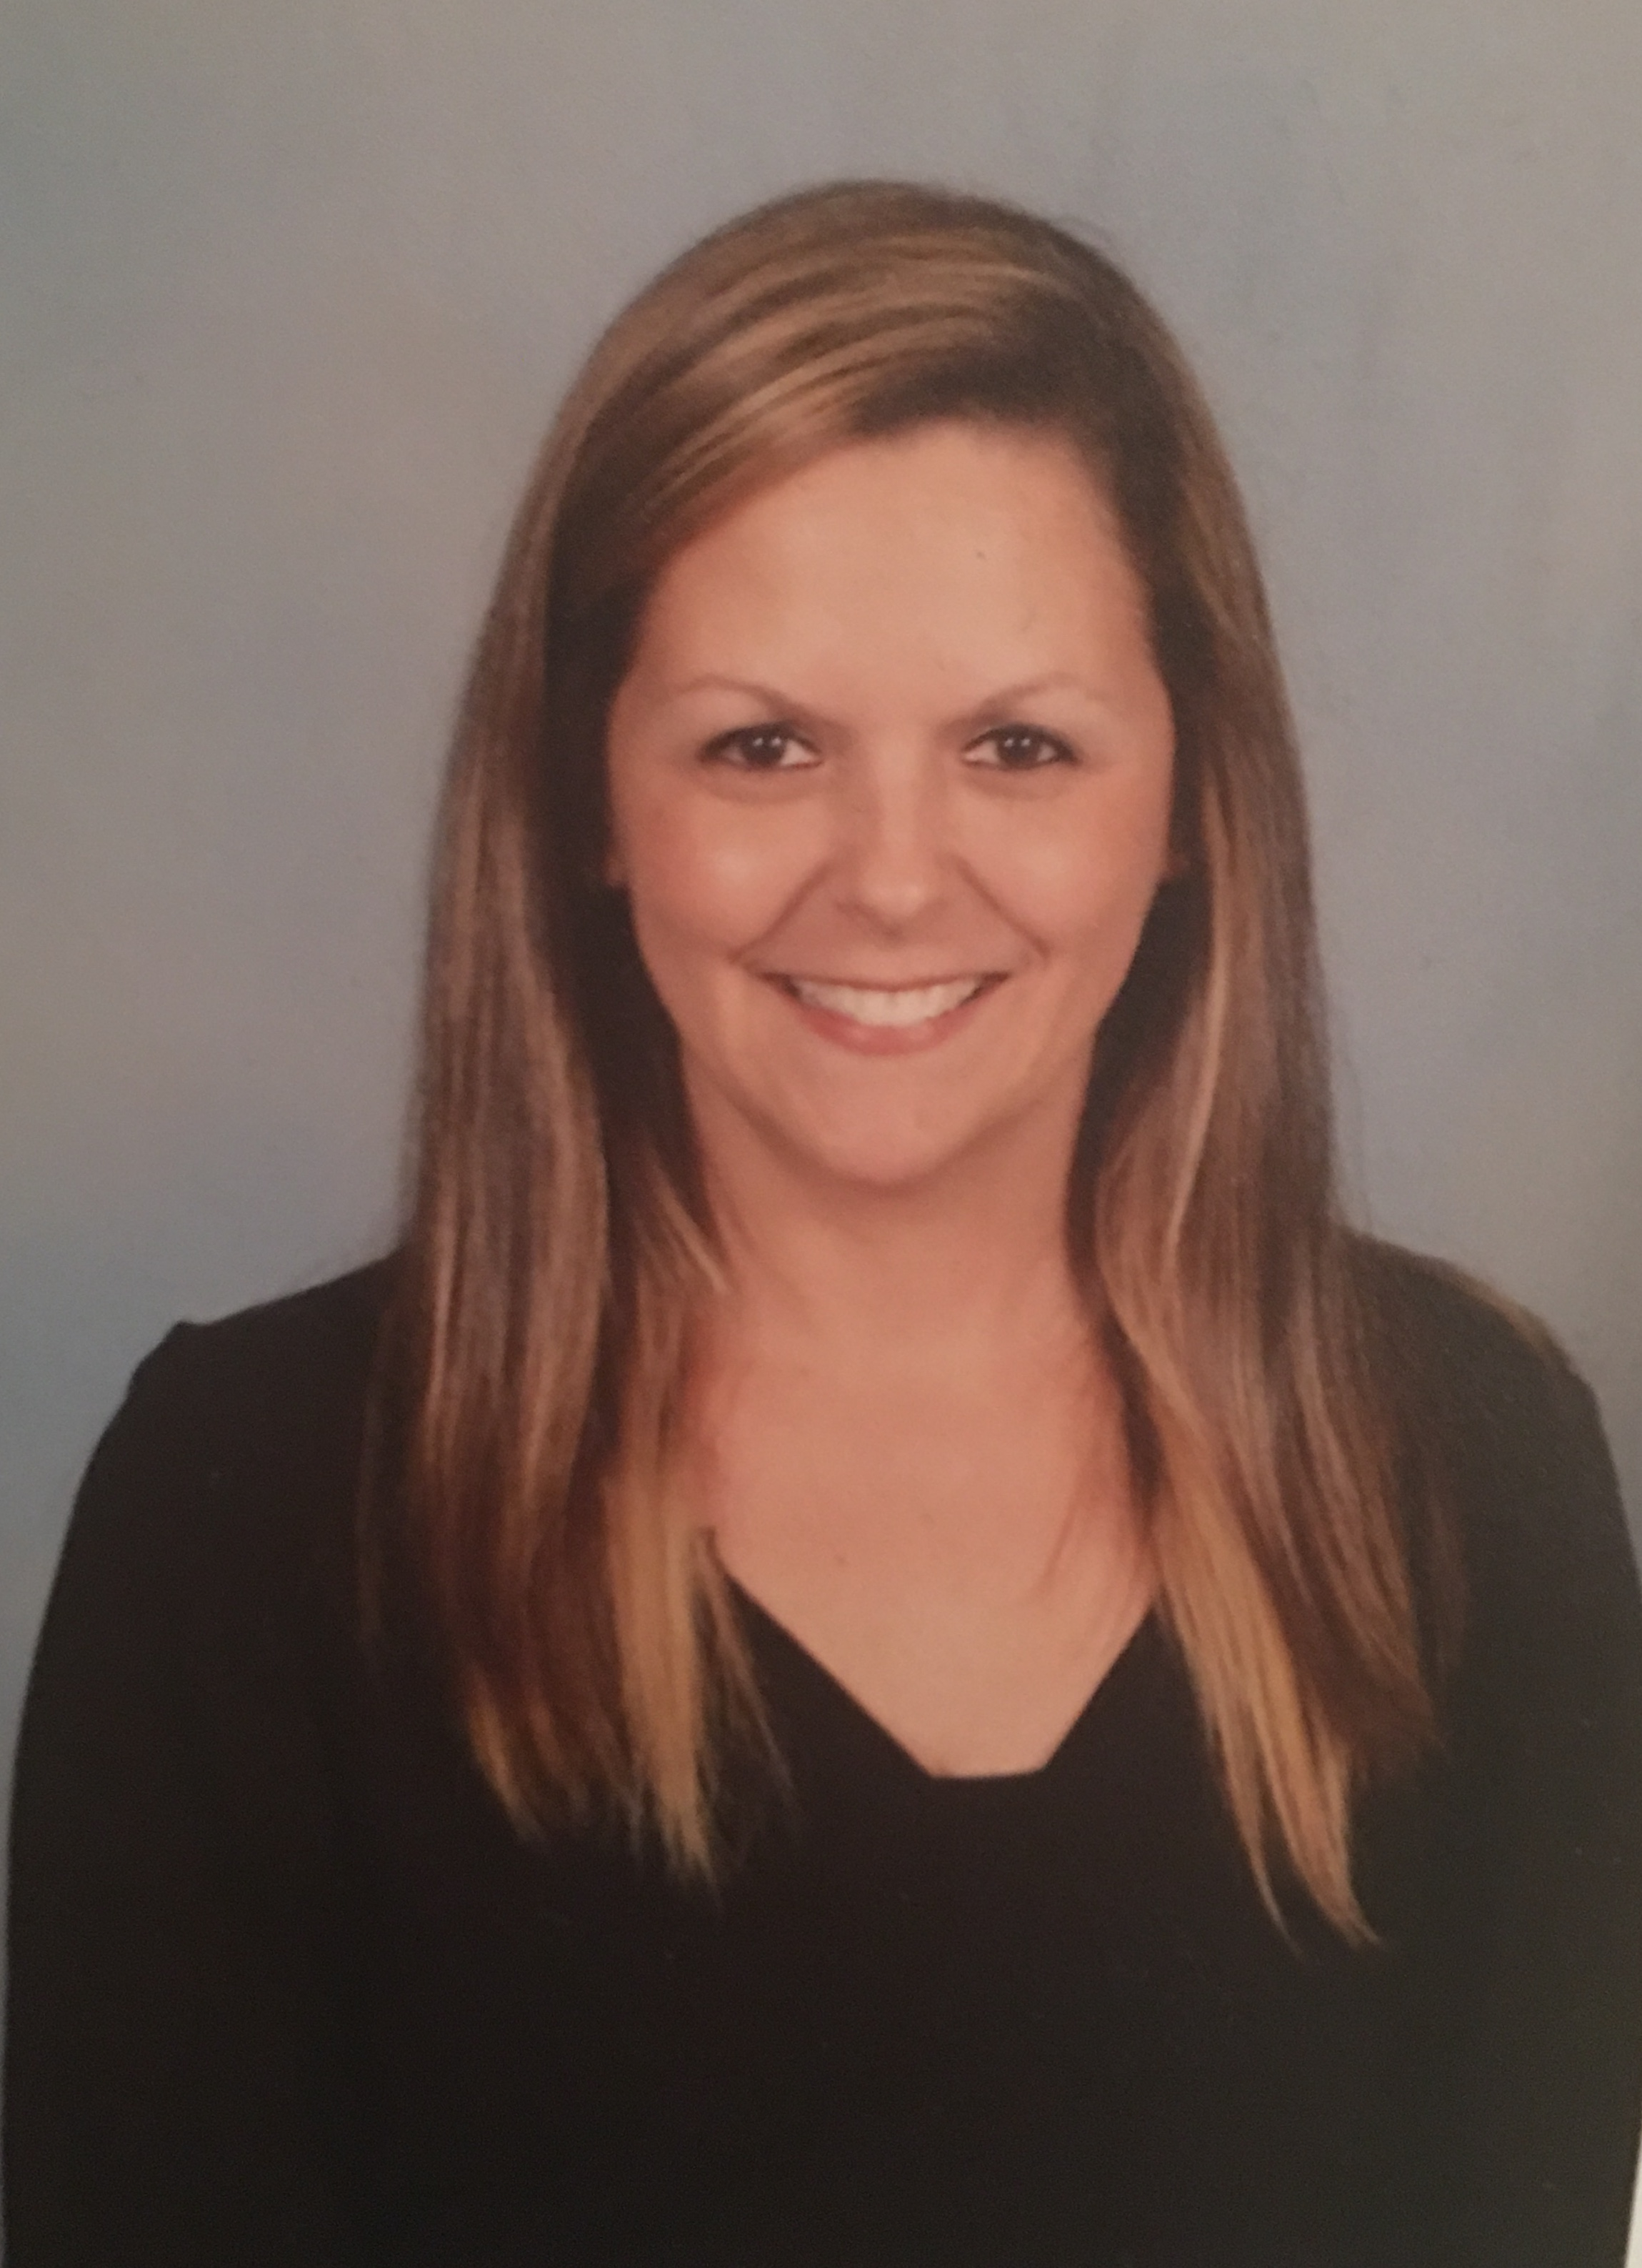
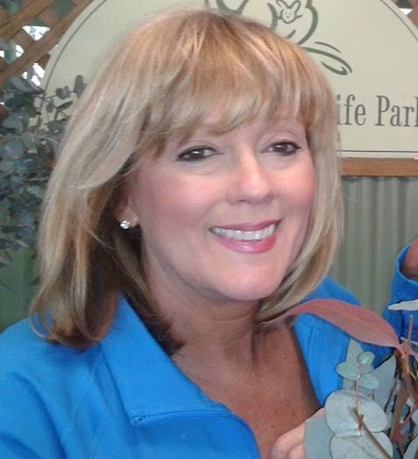
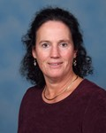
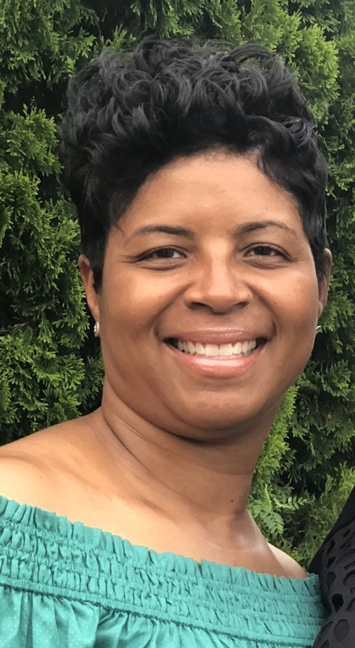
Our 4th Grade Team
Mrs. Hughes
Mrs. Callaway
Mrs. Dees
Ms. McInnis
Mrs. York
Mrs. Hamilton

Slide 3
About Mrs. Hamilton
Married for 15 years – Husband employed at The University of Memphis with Men’s Basketball
3 Daughters – Bailey (13), Brooke (10), and Bella (4)
19th year in the field of education. 1st year at Riverdale Elementary.
Bachelors in Elementary Education from The University of Memphis and Masters in Curriculum and Instruction from Union University

Slide 4
4th Grade Teacher Emails
Mrs. Callaway: amy.callaway@gmsdk12.org
Mrs. Hamilton: TAMARA.HAMILTON@gmsdk12.org
Ms. McInnis: ashley.mcinnis@gmsdk12.org
Mrs. Dees: kelly.dees@gmsdk12.org
Mrs. Hughes: kathie.hughes@gmsdk12.org
Mrs. York: beth.york@gmsdk12.org

Slide 5
Grading Scale
Grading Scale A 93-100 B 85-92 C 75-84 D 70-74 F Below 70 | Conduct Scale E- Excellent G- Good S- Satisfactory N- Needs Improvement U-Unacceptable

Slide 6
Behavior
talking in the classroom
talking/playing/running in line/ramp
not in seat at appropriate times
not following directions
not on task
playing in the classroom
playing/running/jumping in the hallway
8. talking/playing in the restroom
9. inappropriate behavior in the cafeteria
10. disrespectful toward a teacher
11. disrespectful toward another student
12. not paying attention in class
13. Keep hands, feet, and objects to yourself
14. Chewing gum/ eating food in class
15. Missing supplies
Students can move their conduct
for the items listed to the right.

Slide 7
Wednesday Folder
Weekly conduct grades will be sent home along with graded papers in the Tuesday/Riverdale folders. Your parent’s signature on the folder indicates that your parents have reviewed your papers and conduct grade. Important notes from the school will also be placed in the folder. The folder is due back to school Thursday.
Papers below a 70 should be signed and returned.

Slide 8
Homework
Homework/ Take Home folders help students stay organized
May be given every day except Friday in Math and ELA.
ELA homework is given Monday and due Friday. We will take a grade each Friday. It may not be turned in late. It will count as 10% of your child’s grade. The grade will not be based on correct/incorrect answers. It will be based on completion and turning it in on time.
Science/Social Studies- No HW except to study for a test

Slide 9
Money
Please send any money with
the child’s name, teacher
name, amount, and intended
use.
If writing a check, please include your phone number on the check

Slide 10
M & M’s (Mercy Moments)
You will receive an M & M card (mercy moment cards) at the beginning of
each 9 weeks.
Every 9 weeks you will be given one M&M card with 5 punch slots on it. It is your responsibility to keep up with your M&M punch card. If it is lost or stolen, your teacher can not give you more.
You will be able to use these cards if:
1. forgot supplies in another teacher’s class (MAPS, team, Raider Time, etc.)
2. forgot supplies, homework, etc. in backpack after announcements (arrival time)
3.bathroom break at an unscheduled time
4. left lunch box in classroom/cafeteria
*This promotes organization, remembering supplies, and the importance of time management.

Slide 11
DreamBox Learning/Facts Practice Websites
By September 1st all students will have their log-in information.
Request – 7 lessons per week (will make your child a stronger math student)
Treats will be given twice a month for students completing sets of 7 lessons ( a log will be kept in the classroom).
It is SOOO VERY important that all 4th graders have fluency with their multiplication facts. Please spend this first 9 weeks having your student practice at – https://www.topmarks.co.uk/maths-games/hit-the-button and https://www.mutiplication.com/quiz/multiplication-self-correcting-post-test

Slide 12
Tests
Tests
Your teacher will let you know when you will have tests in advance.
Check our websites and teacher emails.

Slide 13
Raider Time
Raider Time (RTI-Response To Intervention)
Everyday 8:45 – 9:30
Students will travel to other classrooms based on ability level and have lessons based on his/her needs. Please try to refrain from checking your child out of school early to maximize their individualized instruction.

Slide 14
Textbooks
Language Arts and Math: They will have module workbooks.
Social Studies: They will receive a newspaper every week.
Science: There will be more information on this to come. It will also be online.

Slide 15
Breakfast/Lunch Money
Give your lunch money to your teacher first thing in the morning.
Breakfast is $ 1.50
Lunch is $2.75. Please make sure that you send enough money for your child. If a parent is writing a check for LUNCH, it is OK for multiple children to be on one check. Just make sure the parent has written how much $ per student.
PLEASE DO NOT COMBINE LUNCH MONEY CHECKS WITH MONEY FOR OTHER ACCOUNTS (EX. FIELD TRIP MONEY)
We want lunch to be a pleasant experience without getting out of seats or sharing/ playing with food. Cafeteria behavior/ expectations are just like they are at a restaurant.
Your parents can visit during our lunch.
Lunch Schedule: 12:15-12:40

Slide 16
Birthdays
Purchased cupcakes or cookies may be passed out during lunch in honor of a birthday.
Only store bought treats(nothing homemade)
Avoid peanut and tree nut ingredients

Slide 17
Attendance
School begins at 8:30. Anytime after 8:30 is considered a tardy.
If you are absent from school, please send an excuse note or email in order to have an excused absence. Any missed assignments will be given to you to complete in a reasonable amount of time, with consideration to the number of days missed.
TARDIES add up. If you are consistently tardy or leaves early from school, the time is tallied against his/her attendance.
Only students that are at school ALL day, EVERY day (8:30-3:30) will achieve perfect attendance. Students who have tardies, check in/outs, and excused absences will NOT have perfect attendance.
After your 3rd tardy or absence within a 9-week period, the homeroom teacher will call the parent.
After the 5th tardy or absence 9-week period, your name will go to Mrs. Creed.
After the 10th tardy or absence 9-week period, your name will go to an administrator.

Slide 18
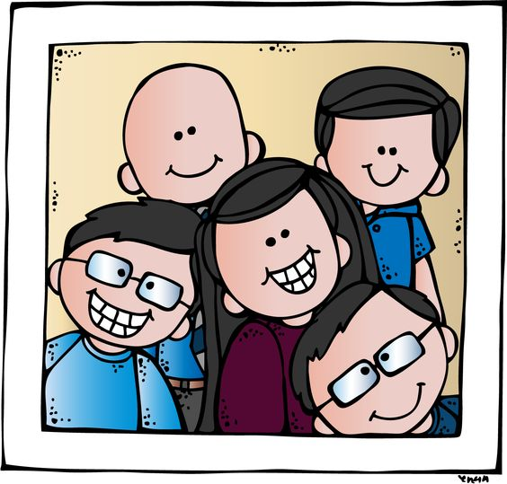
Visitors must go the the office before entering the school.
The front office is located in the new middle school building.

Slide 19
Inclement Weather
The inclement weather handout will assist us in how your child will go home should we get out of school early for bad weather or emergencies. Rapid call will make a phone call home letting you know that school is dismissing early.

Slide 20
Medicine
We have a medication policy and students are not allowed to carry any type of medicine to school. We do not administer over the counter meds; however, the parent can bring OTC meds to the clinic and administer them as needed. According to state law TCA 49-5-415, all student’s carrying an inhaler or keeping one in the clinic must have an Asthma Action Plan signed by a physician and a parent signed medication authorization form on file. All students needing an Epi pen must have a Severe Allergy Plan signed by a physician and a parent signed medication authorization form on file. These forms along with directions are available from the school clinic.

Slide 21
Interims
Interims will be sent home in your child’s Tuesday folder between the 4th and 5th week of the 9-week grading period. This will give you an update on your progress. Please sign and return the interim on the next school day.

Slide 22
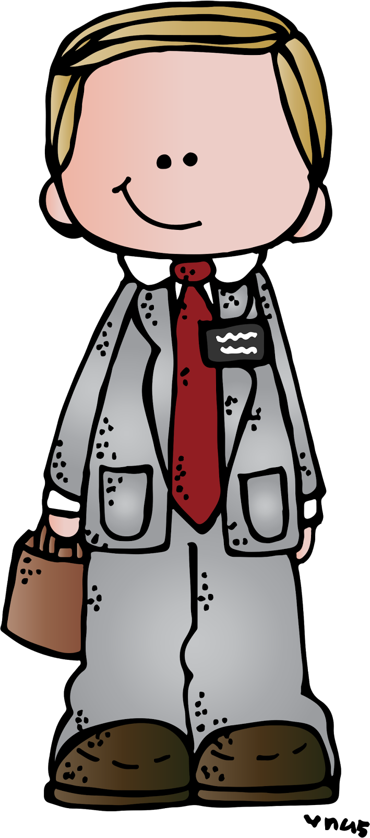
Dress Code
Germantown Municipal School District Dress Code Apparel or appearance that tends to draw attention to an individual rather than to a learning situation must be avoided. In matters of opinion, the judgment of the principal/designee shall prevail. To help create the best learning environment for students, the following standards for student dress must be observed in all Germantown Municipal Schools:
1. Pants must be worn at the waist, must be appropriately sized, and at a safe length.
2. Shirts, blouses, and dresses must completely cover the abdomen, back, shoulders and must have sleeves. Shirts or tops must cover the waistband of pants, shorts, or skirts with no midriff visible. Low-cut blouses, shirts or tops, extremely tight tops, tube tops, or any top that exposes cleavage are prohibited. Shirts, blouses, and tops must be no longer than wrist-length.
3. Head apparel (such as hoods, hats, etc.), except for religious or medical reasons, must not be worn inside the school building.
4. Footwear is required and must be safe and appropriate for indoor or outdoor physical activity.
5. Clothing and accessories such as backpacks, patches, jewelry, and notebooks must not display (1) racial or ethnic slurs/symbols, (2) gang affiliations, (3) vulgar, subversive, or sexually suggestive images; nor should they promote products which students may not legally buy, such as alcohol, tobacco, and illegal drugs.
6. For students in Grades 3-12, “short shorts”, mini-skirts, and skin-tight outer material, such as spandex, are inappropriate attire. No shorts or skirts shorter than 4 inches above the knee are allowed.
7. Waist length sweaters, sweatshirts, and lightweight jackets (appropriately sized) can be worn inside school for warmth.
8. Prohibited items include (1) large, long, and/or heavy chains, (2) studded or chained accessories, (3) sunglasses, except for health purposes, (4) sleepwear, pajamas, blankets (5) skin-tight outer materials such as spandex or leggings; and (6) facial jewelry (including tongue piercing).

Slide 23
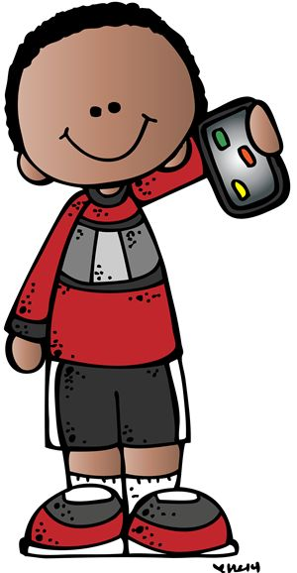
Cell Phones
Possession of any type of phone, personal communication, or electronic communication device at any time during the regular day is prohibited!
Above devices should be turned off and kept in backpacks.
If we see them, we take them and you (the parent) will need to pick them up from the office.

Slide 24
Skyward
You should have a username and password to log into Skyward to see your
child’s grades.

Slide 25
Honor Roll
Principal's Honor Roll: All A’s and All E’s,
including MAPs conduct
Academic Honor Roll: Equal or better A’s and
B’s (with no N’s, or U’s in conduct), including MAPs conduct
Citizenship: All E’s in conduct, including MAPs conduct
Perfect Attendance: Present every day, with no late check-ins or early check-outs

Slide 26
Fun Friday
We will have Fun Friday the first Friday after report cards go home.
Your child must earn all A’s and/or
B’s, E’s, G’s and S’s to attend. Students not attending Fun Friday will be in a supervised study hall.

Slide 27
Parent Volunteers
School tutoring- Tuesday/Thursday 7:30
Head Room Parent
Class parties, field trips, activities
Donate to class- see wish list on board
Join the PTSA!!!
Box Tops

Slide 28
Academic Schedule
Homeroom 8:30-8:45
RTI 8:45- 9:30
MAPS 9:30-10:15
1st period 10:15-11:35
2nd period 11:35-1:50
Recess 11:45-12:00
Lunch 12:15-12:40
3rd period 1:50-3:25

Slide 29
MAPS schedule
Time | Monday | Tuesday | Wednesday | Thursday | Friday
Hughes | Art- Sutton | B Gym | Music- Caudle | Library-A Guidance-B | B Gym
Dees | B Gym | Art- Sutton | B Gym | Music- Caudle | Library-A Guidance- B
York | A Gym | Guidance- A Library- B | Art- Sutton | A Gym | Music- Short
Callaway | B Gym | Music- Caudle | B Gym | Music | Guidance-A Library- B
McInnis | A Gym | Art- Cychowski | Guidance- A Library-B | A Gym | Music- Caudle
Hamilton | Music- Caudle | B Gym | Art- Cychowski | Guidance-A Library-B | B Gym

Slide 30
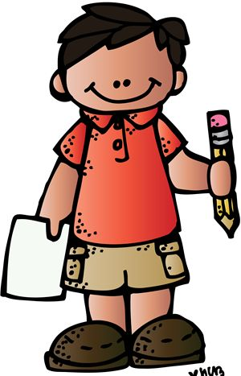
Important Dates
Look for important dates on our websites/ Google calendar
Websites:
Riverdale: http://www.gmsdk12.org/riverdaleelementary_home.aspx
Riverdale PTO http://riverdalepto.com/
GMSD: http://www.gmsdk12.org/

Slide 31
Mrs. Hamilton’s Wish List
Packages of candy – **no peanut butter please** (Smarties, suckers, Sweet Tarts, Skittles, M&M’s, chocolate, Laffy Taffy, etc.)
Recess games – ones from home that are in good shape or new
Reams of copy paper (white and color)
Page Protectors
Glass Cleaner (for laptops)

Slide 32
Thank you so much for coming!!

